Slide 1
Printed circuit board (PCB)
Aniruddh Pandey

Slide 2
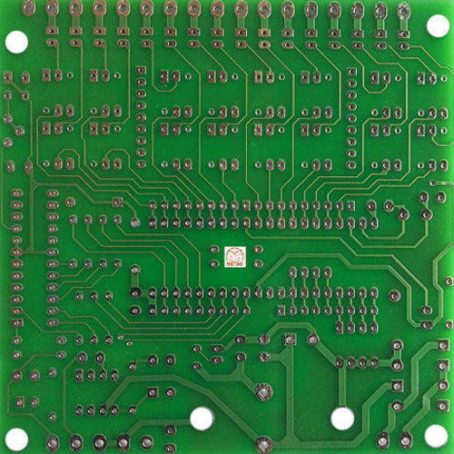
What is a PCB?
A printed circuit board (PCB) is a laminated sandwich structure of conductive and insulating layers.
PCBs mechanically support electronic components using conductive pads in the shape designed to accept the component's terminals, and also electrically connect them using traces.
PCBs can be single-sided (one copper layer), double-sided (two copper layers on both sides of one substrate layer), or multi-layer (outer and inner layers of copper, alternating with layers of substrate.

Slide 3
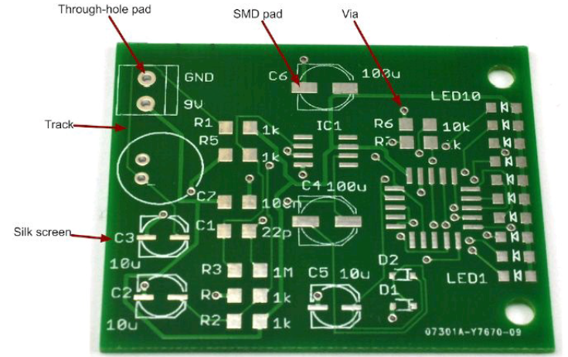
A few Components…
Pads are where the components are soldered to the PCB
Tracks are the copper tracks that connect pads together
Vias are small holes through the board that link a bottom and top track together electrically
Silk-screening refers to any lettering that will appear on the final board
Stop mask is a layer of insulating lacquer that covers both sides of the board except where
there are pads.

Slide 4
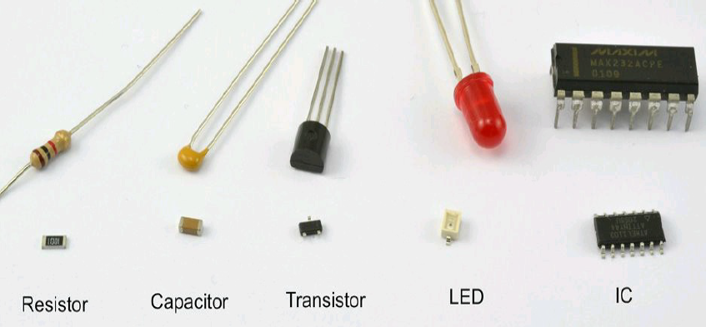
Through hole
Surface mount
Through-hole-technology (THT) involves inserting leads of components into drilled holes in the PCB. Leads can then be soldered onto pads or lands on the solder side of the board, usually with a simple soldering iron by hand or wave soldering process.
SMD components (Surface Mount Devices) are the electronic function parts, which are soldered to the circuit board by surface mount technology and are replacing through-hole components in most commercial products.

Slide 5
Prototyping…
Ultimately, if you want to produce something of professional quality, then PCBs are the only way to go.
However, while you are prototyping a design, it is a very good idea to test out your design before you start getting PCBs manufactured. Every time you find something wrong with your design and have to get a new batch of PCBs made, you will be increasing costs, both in time and in money. It is far better to get the design as perfect as possible before you commit to a board.
A few methods…
Solderless Breadboard
Perfboard
Stripboard

Slide 6
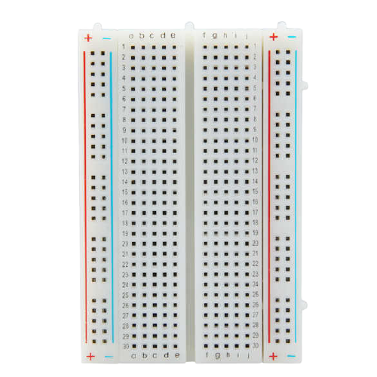
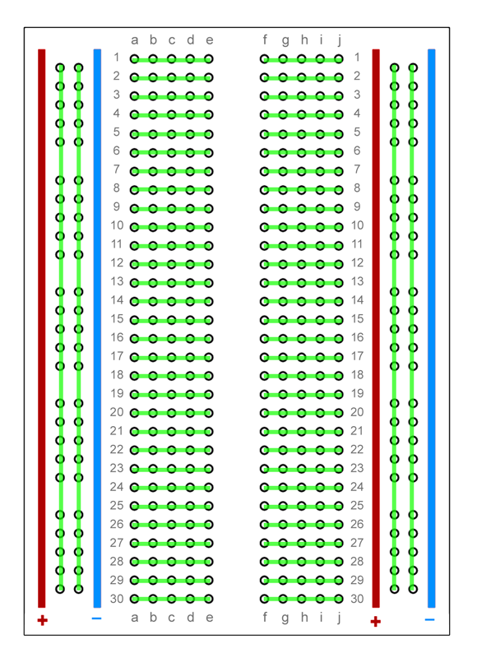
Solderless Breadboard
Solderless breadboard is very useful for quickly trying out designs before you commit them to solder. You poke the leads of components into the sockets, and metal clips behind the holes connect all the holes on a row together.

Slide 7
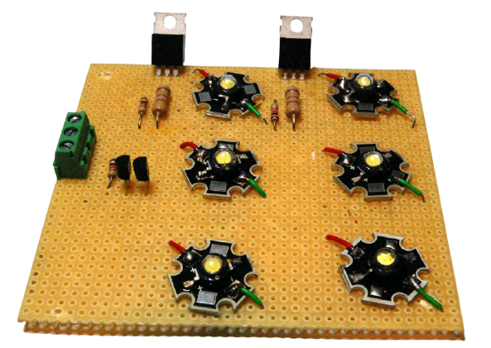
Perfboard
Perfboard (perforated board) is one of a number of types of board designed specifically for prototyping. It is made from the same material as a PCB but has no copper on it. It is just a board with an array of holes in it on a 0.1-in. grid.
Component leads are pushed through from the top and soldered together underneath using either their leads (if they will reach) or lengths of solid-core wire. The perfboard effectively provides a rigid structure to keep the components in position.

Slide 8
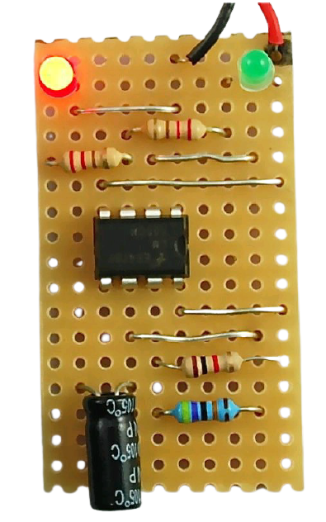
Stripboard
Stripboard is a bit like general-purpose PCB. It is a perforated board with conductive strips running underneath, rather like breadboard. The board can be cut to the size you need, and components and wires are soldered onto it.
As with breadboard, laying out a project on stripboard requires a bit of skill to rearrange the logical layout of the schematic into something that will work with the strips of the stripboard.

